Slide 1

MULTIPROGRAMMED SERVER Performance Evaluation of Computer System and Networks
Califano Tommaso • Ramacciotti Nicola • Suma Gabriele
Master degree in Computer Engineering, 1st year
Year 2023/24, fall term

Slide 2
Table of contents
01
02
03
04
05
Overview
Model
Implementation
Objectives and key performance indexes
Theoretical model, assumptions and factors
Omnet++ model and verification tests
Data Analysis
Conclusion
Calibration and simulations scenarios

Slide 3
01
Overview

Slide 4
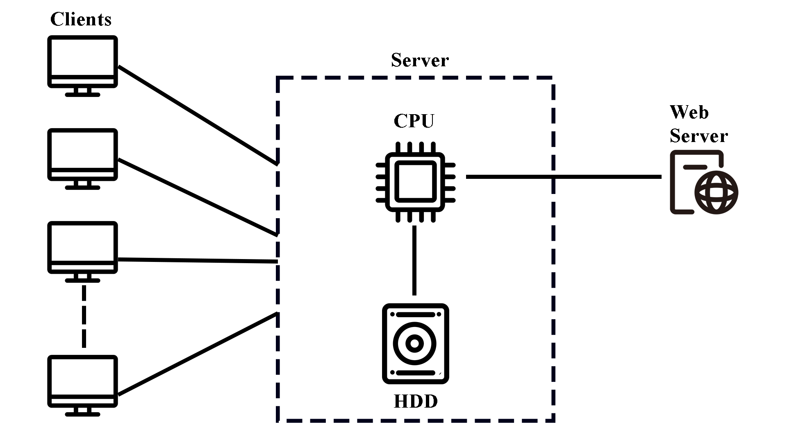
Overview
Objectives:
Throughput
Utilization
Key performance indexes:
Throughput: the number of completed transactions per unit of time.
Utilization: the time percentage during which each node is busy.

Slide 5
02
Model

Slide 6
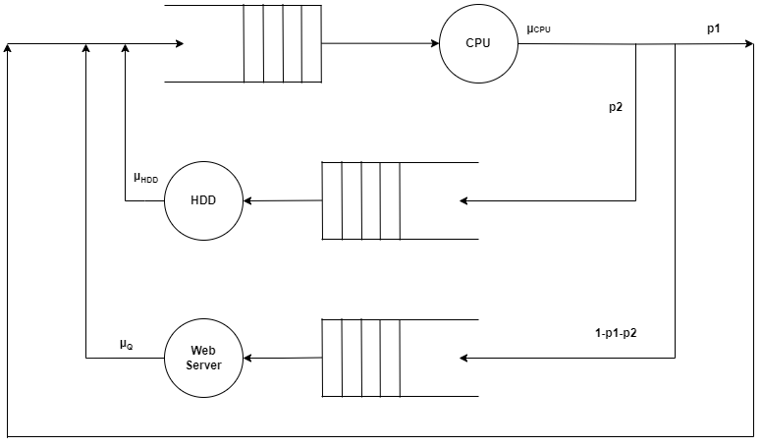
Model
Assumptions
Finite number of clients = number of jobs within the system.
Infinite queue size
Service centers: exponential distributed service time with a different rate and FIFO order processing.
p2
µ_{HDD}
Factors
N
µ_{CPU}
p1
µ_{WS}

Slide 7
03
Implementation

Slide 8
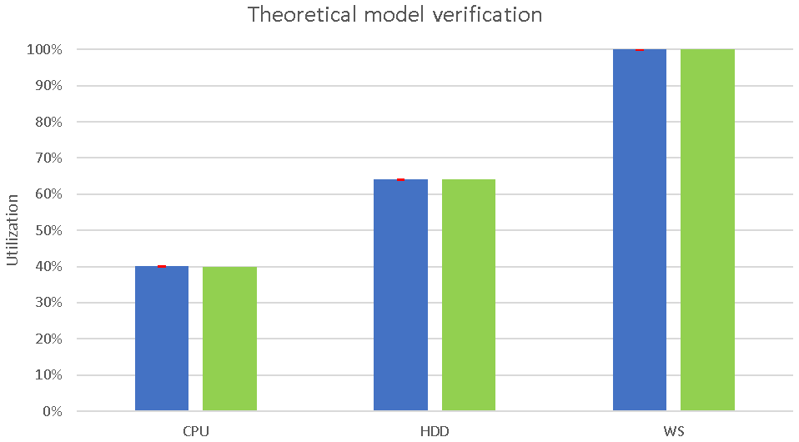
Omnet++ Model
Server
Client
CPU
HDD
Confidence level: 99%
Empirical utilization
Web Server
Theoretical utilization

Slide 9
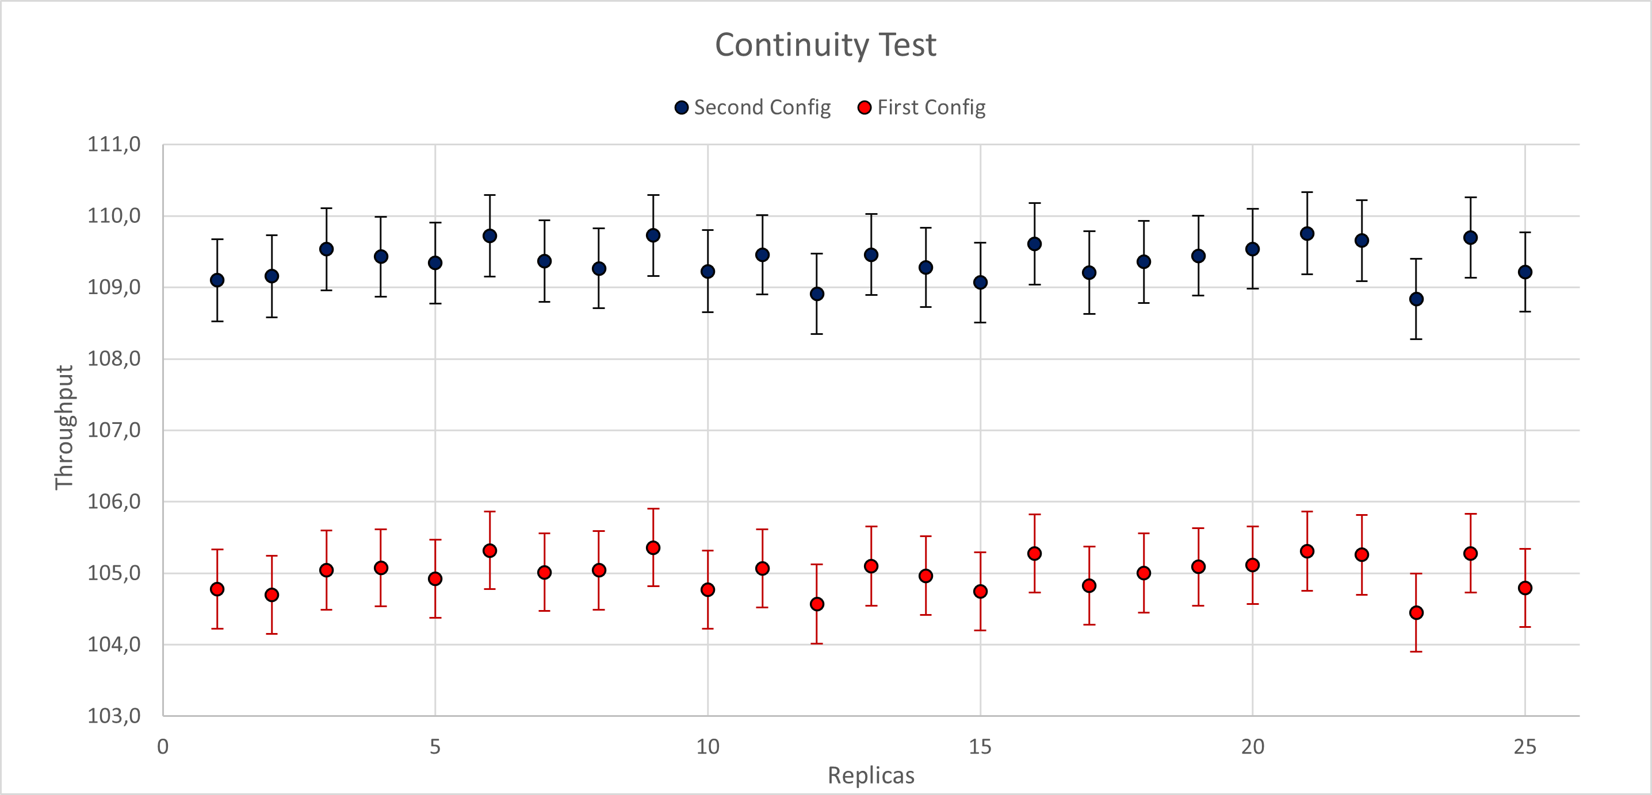
Verification
Continuity Test
Second Config
p1 = 0.35 | µ_{CPU} = 1000
p2 = 0.41 | µ_{HDD} = 250
 | µ_{WS} = 75
Number of clients = 40
First Config
p1 = 0.35 | µ_{CPU} = 1000
p2 = 0.40 | µ_{HDD} = 250
 | µ_{WS} = 75
Number of clients = 40
Confidence level: 95%

Slide 10
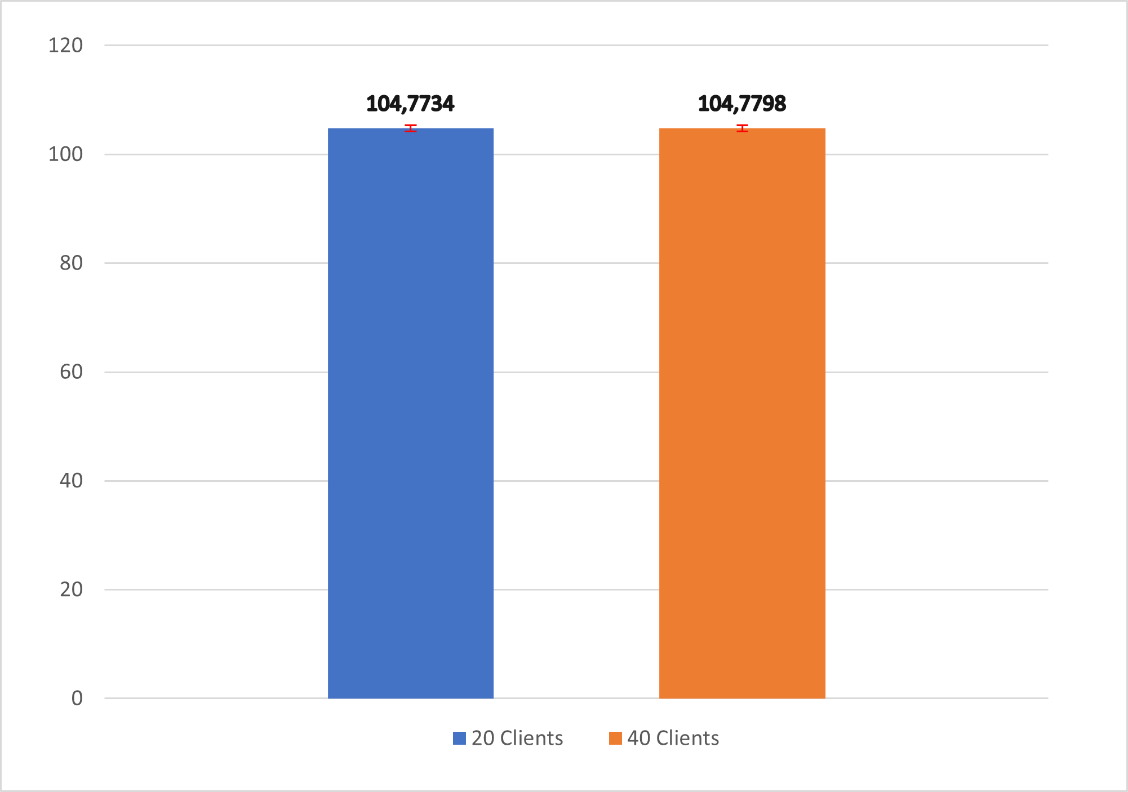
Verification
Consistency Test
Common Values
p1 = 0.35 | µ_{CPU} = 1000
p2 = 0.40 | µ_{HDD} = 250
 | µ_{WS} = 75
20 Clients
40 Clients
Confidence level: 95%

Slide 11
04
Data Analysis

Slide 12
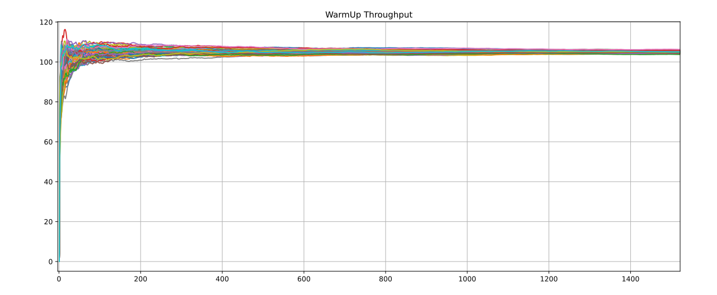
Calibration
Warm-up evaluation
Repetitions
The experiment was based on 100 repetitions
Gathered data
All data were analyzed with time average function
Final Value
500s warm-up period

Slide 13
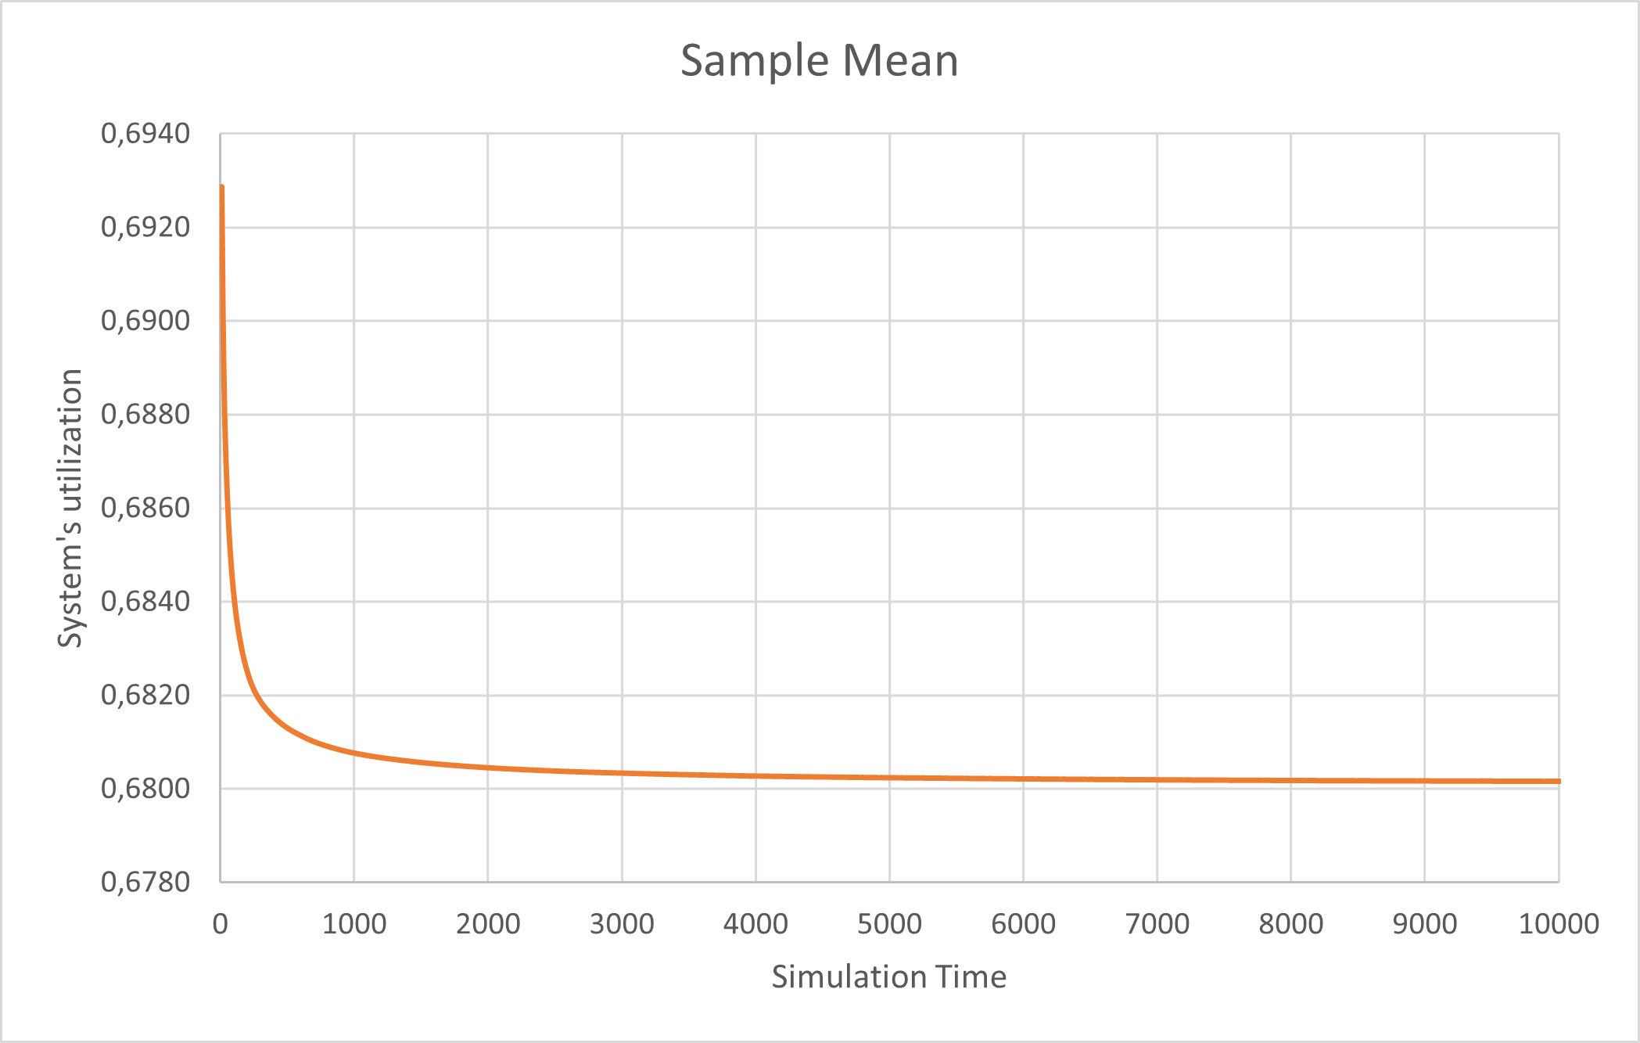
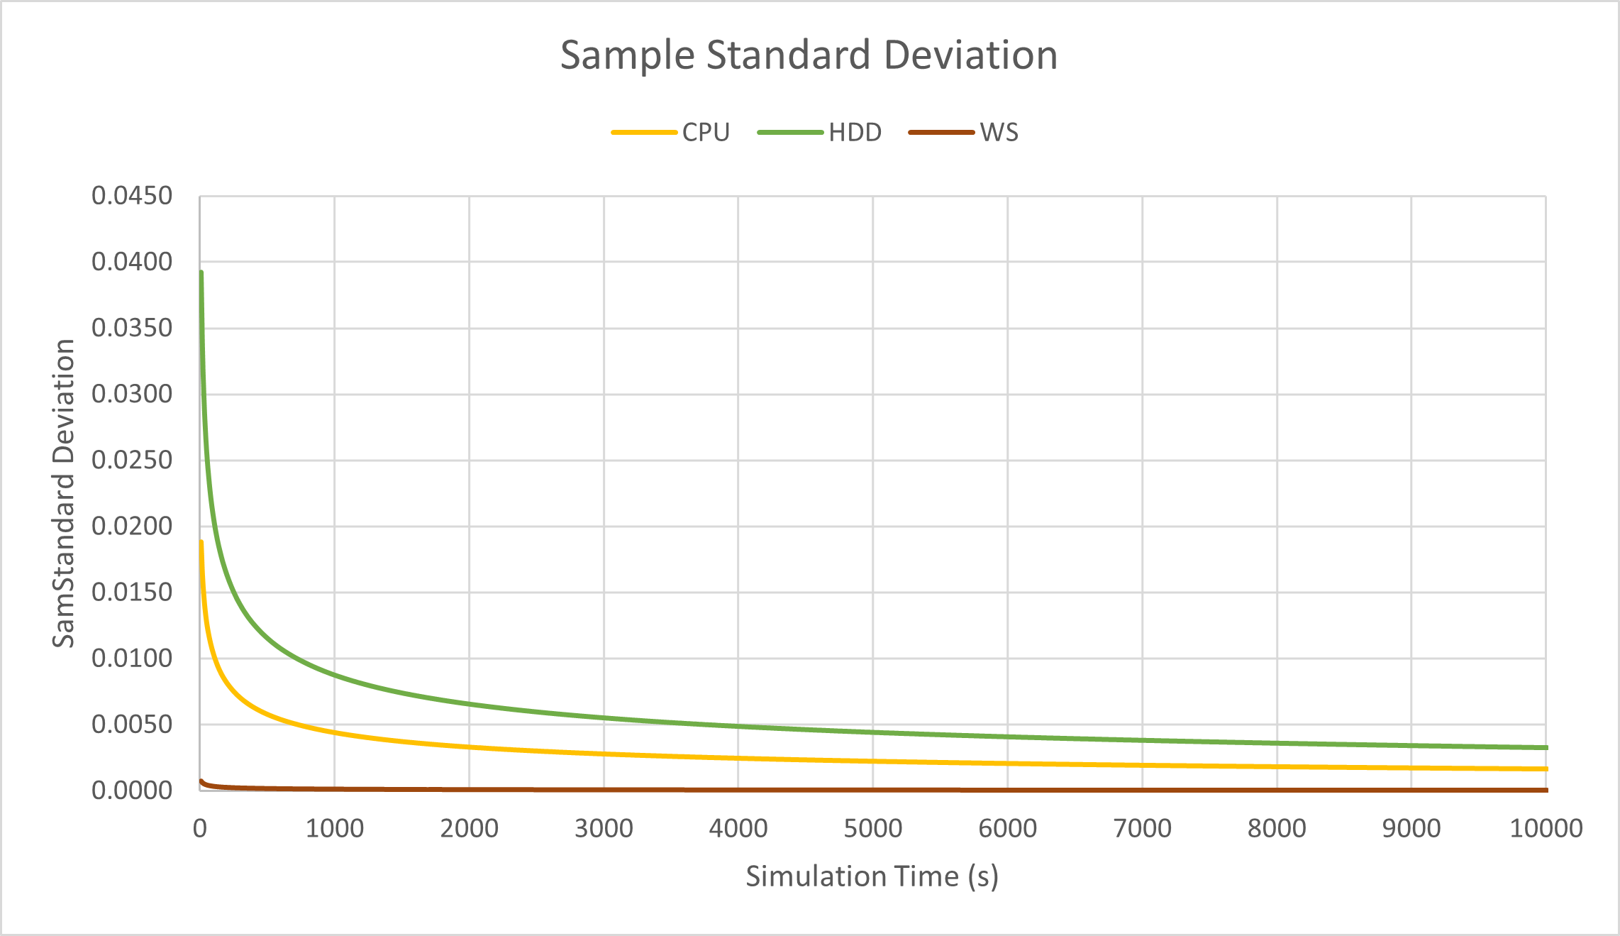
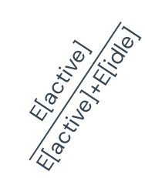
Calibration
Simulation Time
Repetitions
Theoretical Verification
Final Value
500 repetitions
Sample mean & Sample Standard Deviation
Gathered Data
The sample mean converges to
4000s simulation time
$$\frac{\text{E}\text{[}\text{active}\text{]}}{\text{E}\text{[}\text{active}\text{]+}\text{E}\text{[}\text{idle}\text{]}}$$

Slide 14
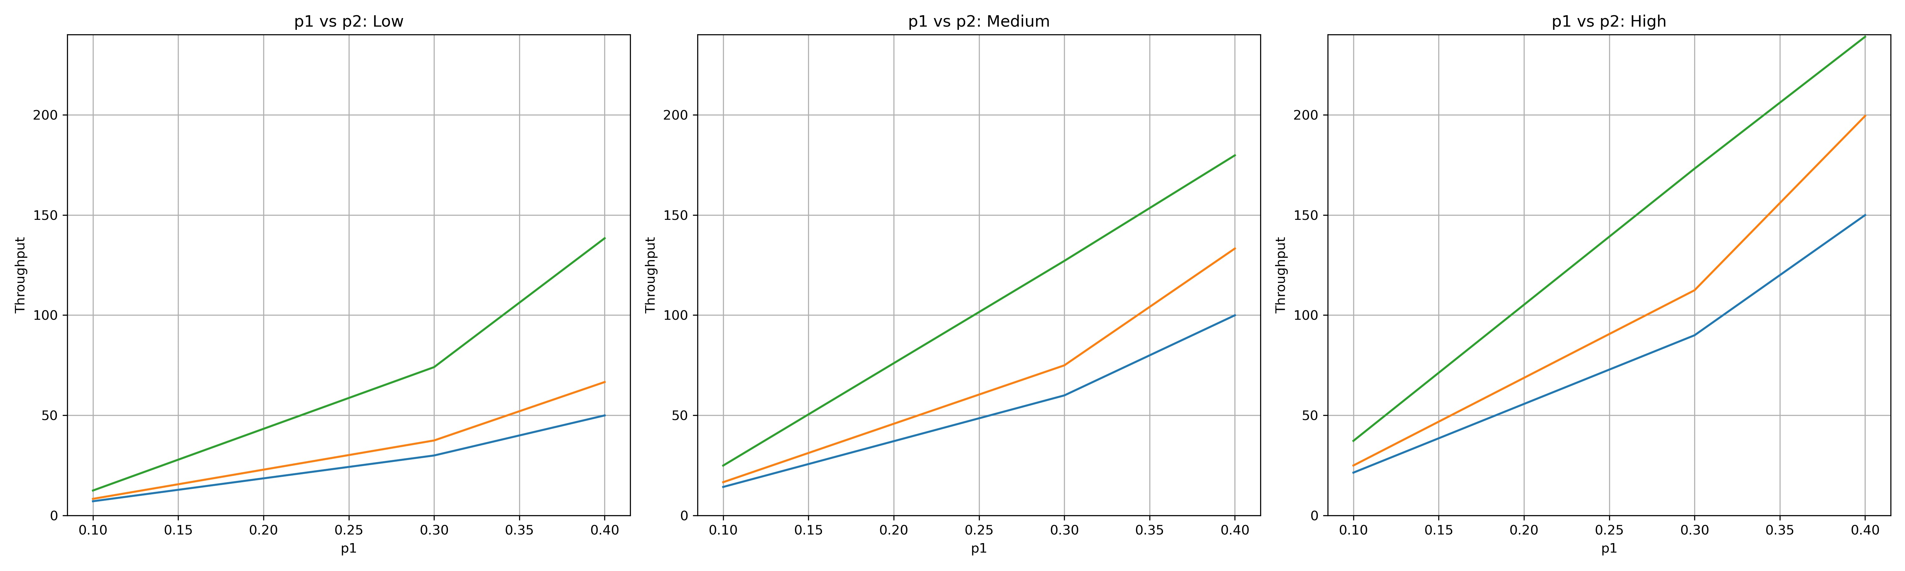
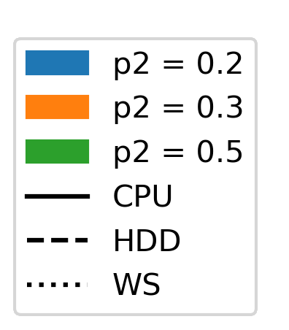
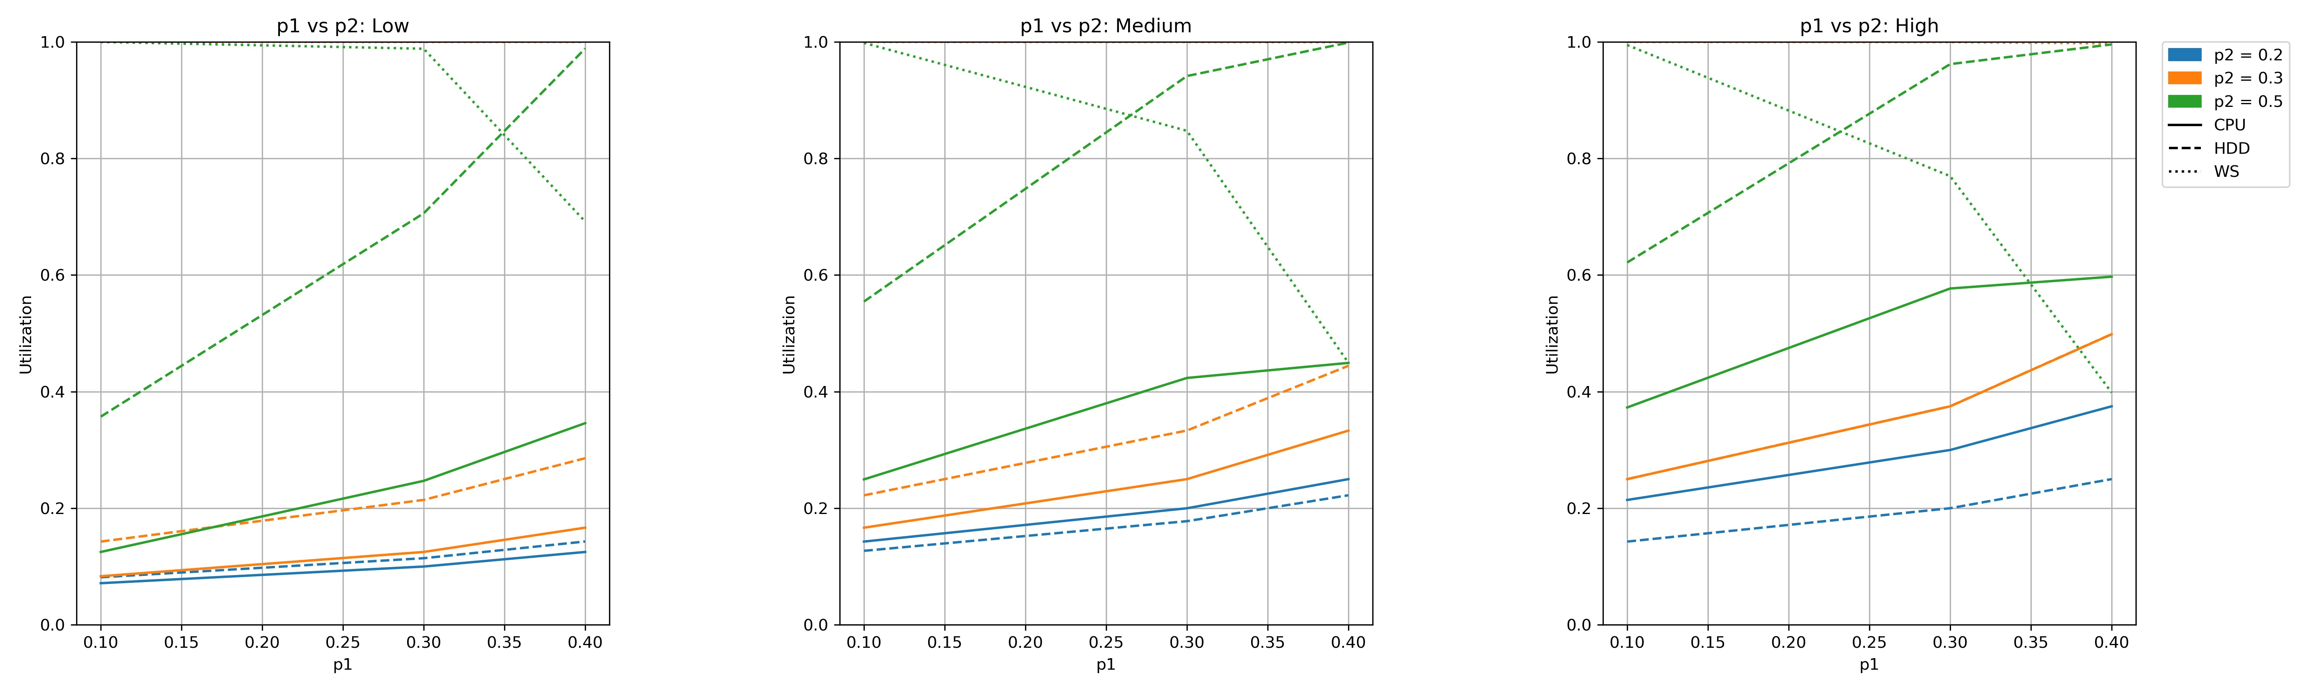
Simulation Scenarios: p1 vs p2
Low
Medium
High

Slide 15
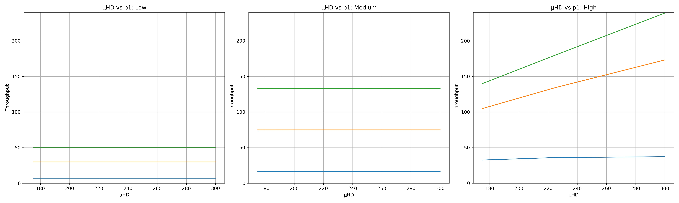
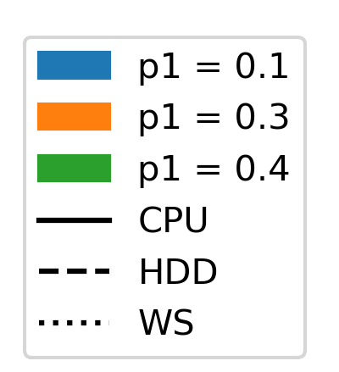
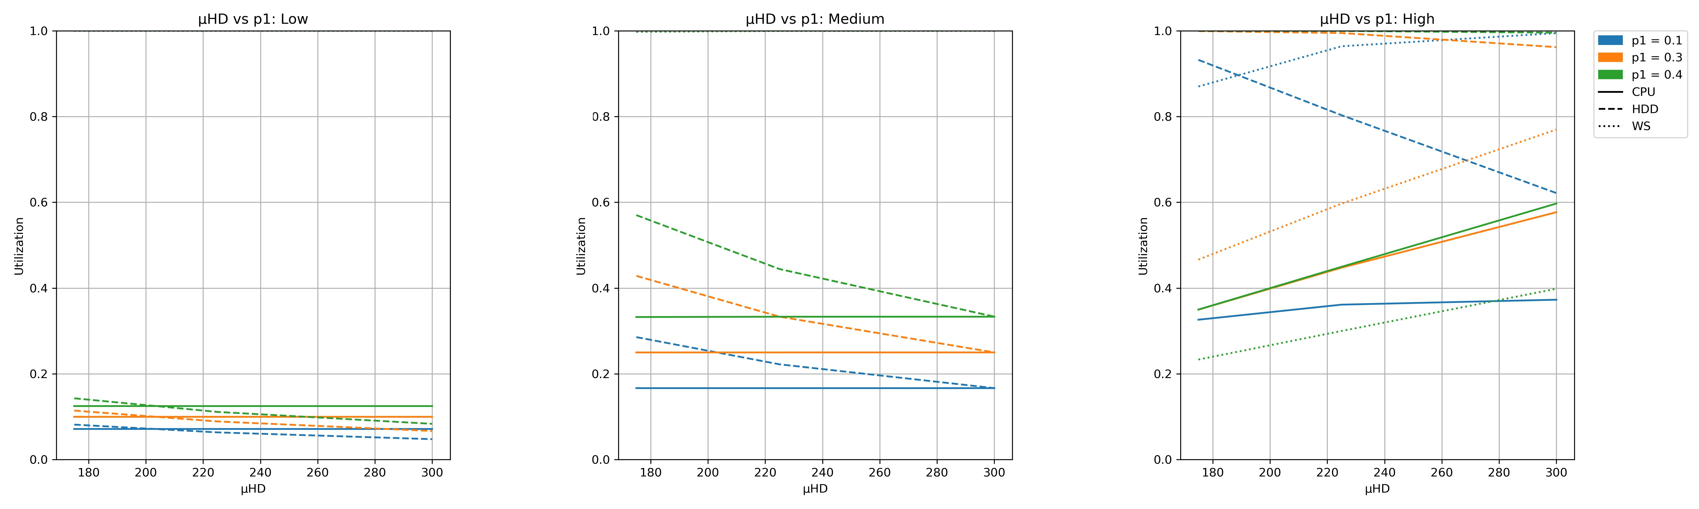
Simulation Scenarios: µ_{HDD} and p1
Low
Medium
High

Slide 16
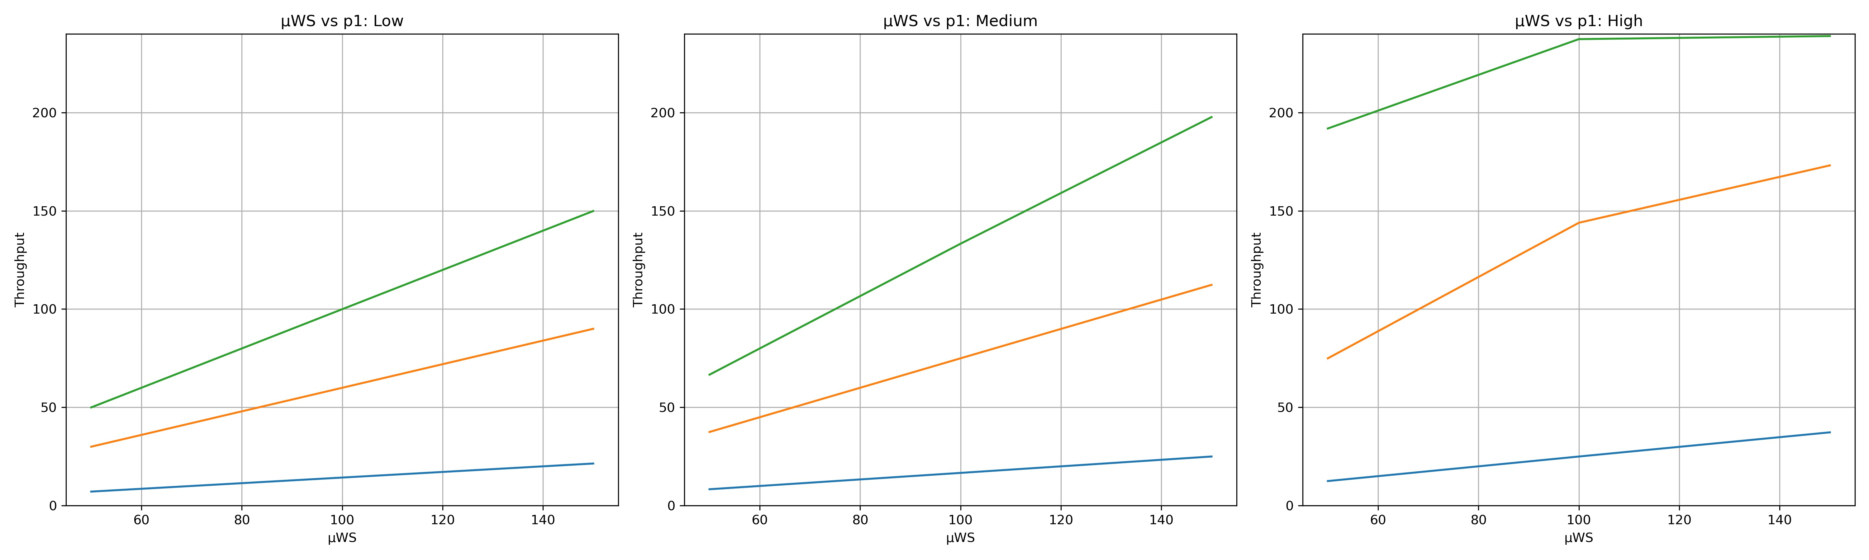
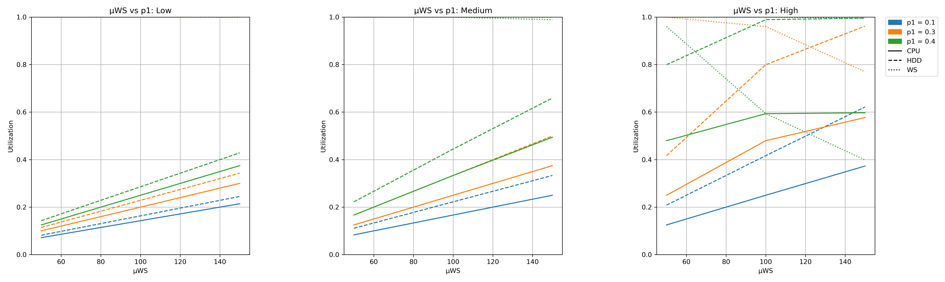
Simulation Scenarios: µ_{WS} and p1
Low
Medium
High

Slide 17
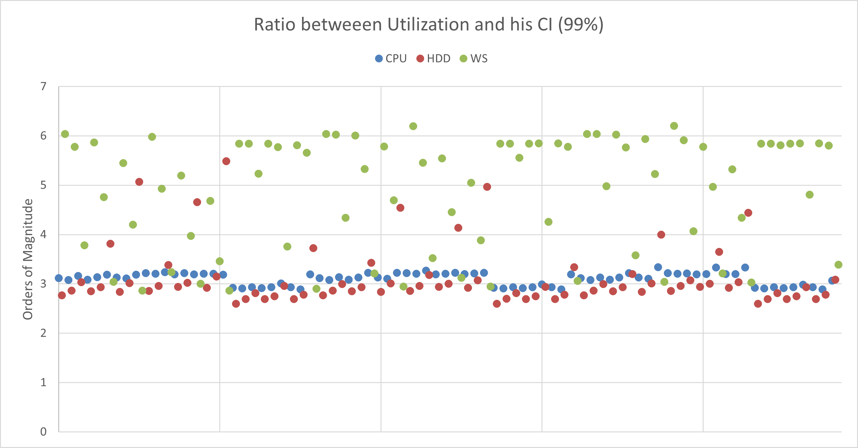
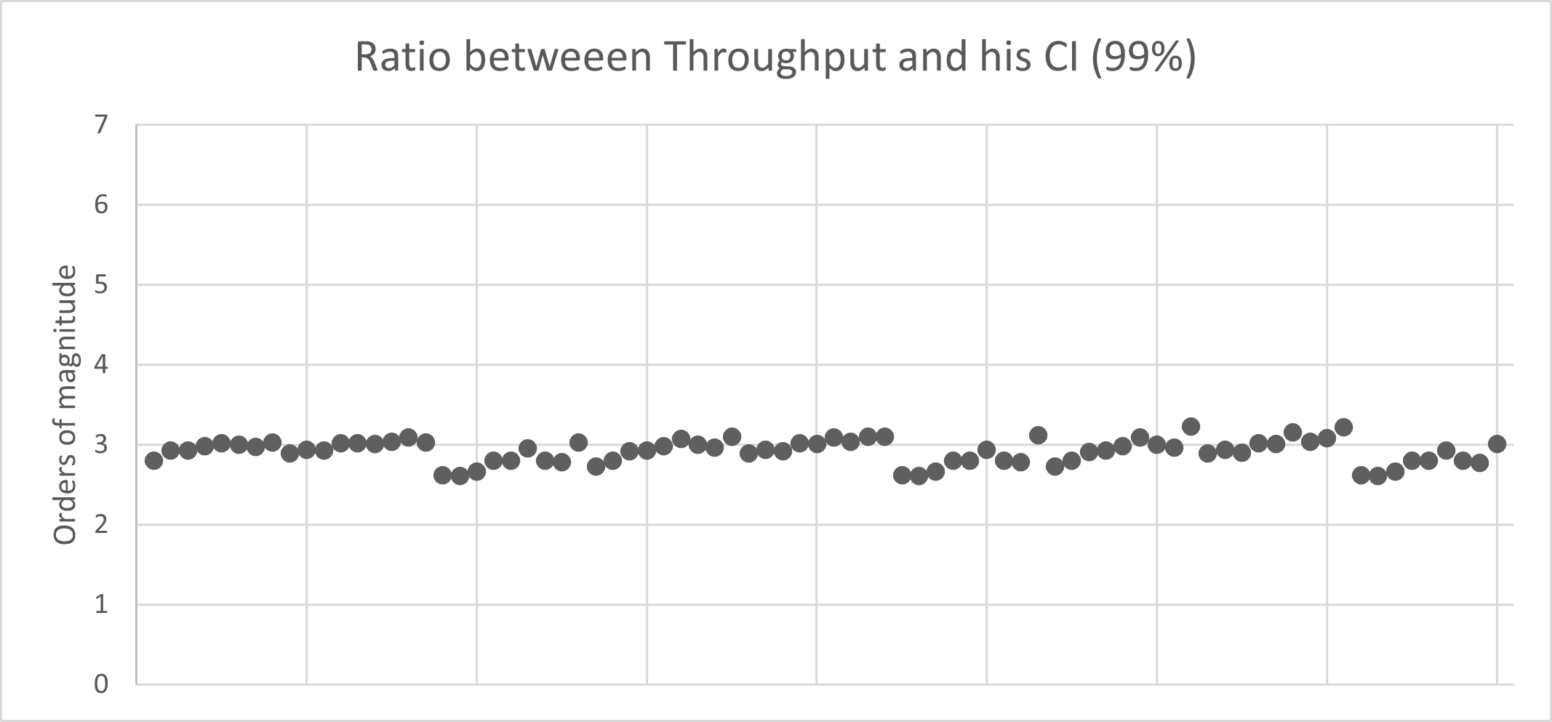
Confidence Interval
Web Server
CPU
HDD
Server

Slide 18
05
Conclusions

Slide 19
Conclusions
First Scenario
Second Scenario
Situation
Situation
Vast amount of local computations.
Minimal interaction with Web Servers.
Minimal local processing.
Relies on cloud-based computations.
In the model
In the model
p2 is expected to be high due
to the significant load on the local server.
p2 is likely to be low due to the high volume of requests to the remote web-server.
Solution
Solution
Increase µHDD to improve the throughput of the system.
Increase the µWS to boost the throughput
of the system.

Slide 20
Thanks!

